Slide 1

Index Description
This presentation gives an overview of the various aspects of 2 graphs that can be used as an index for AI and DL adoption
Lebanon, Aug 15, 2019
Toni Narciss

Slide 2
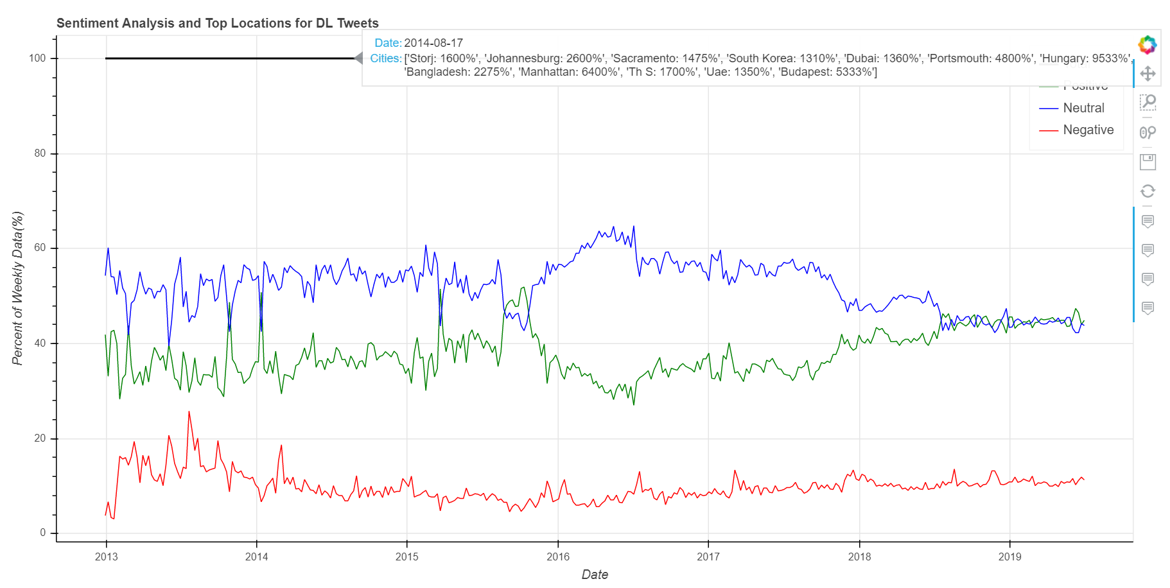
Index 1 and 2
Cass Business School
Index Description

Slide 3
Index 1 and 2 (Continued)
Description This dynamic chart looks at the sentiment of tweets from 2013 till the present by looking at weekly intervals. It also shows the hot/spiking locations for each month.
Structure The line chart has 1 line for each positive, neutral and negative sentiment and each point on those lines shows what percentage of the tweets in that week was positive, neutral and negative, respectively. In addition, there is a line showing the total sentiment which is always at 100% and this line is used to show the locations with a significant increase in twitter mentions relative to the previous month.
Functionality Details can be seen by simply hovering over the line; this will show a text box including the date, sentiment value(%), and hot locations. The x-axis is also dynamic which means that using the box zoom functionality on the side the user can select any range and the graph axes will adjust automatically.
Data There are 2 such graphs, one is for the Distributed ledger related tweets(displayed above) and the other is for the AI related tweets.
Purpose The graph above can be used as an index for the introduction of new ideas within the AI and DL spheres on a macro level. E.g. the above graph shows significant decline in neutrality of people’s sentiment to DL in the past 2 years.
Positioning Since this is a macro index it is best used at the beginning of the website to introduce the user to the data being covered.
Cass Business School
Index Description

Slide 4
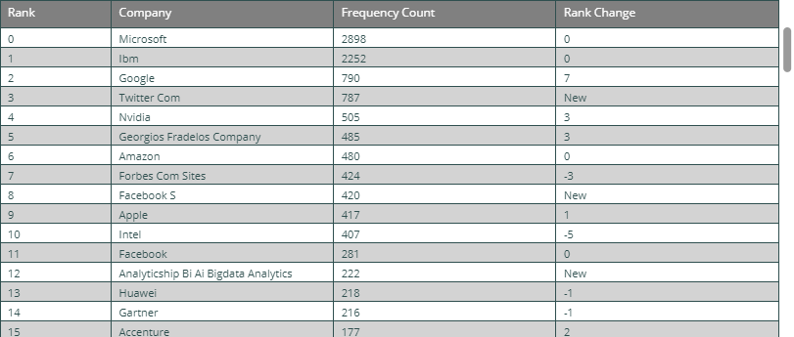
Index 3
Cass Business School
Index Description

Slide 5
Index 3 (Continued)
Description This is a static table that shows the top 100 companies per month. The top 100 are chosen based on the frequency count.
Structure The table has firstly the rank. Secondly, the company name. Thirdly, the frequency count of the company which is the number of times a company was detected in the DF per month by Spacy’s named entity recognition functionality. Lastly, the rank change which shows if the company moved up or down the chart from the previous month and by how many rank points, or displays new
Functionality The table has a simple scroll bar on the side.
Data There are 2 such tables for each month, one is for the Distributed ledger related tweets and the other is for the AI related tweets. This results in 156 tables since 2013.
Purpose The table is dominated by established companies and shows new entries occasionally. Thus it can be used to gauge the public’s perception of AI and DL technology adoption among the established companies. Furthermore, by focusing on the companies that are “NEW” to the list the user can identify emerging companies and the sub-industry that these new-entrants might share.
Positioning These lists can be used as a product on the website that are displayed
Cass Business School
Index Description

